Slide 1
[Session Title]
[Speaker]
R/Medicine 2025

Slide 2
[Section]

Slide 3
Your Turn #1
Use green Tw Cen MT 44 for text
Use blue Monaco 36 for code
Be explicit about mode of feedback (e.g.: Click “yes” when you are finished.)

Slide 4
R Markdown
Notes:
(Might wan to mention here – next few min will be background and not critical to understand the rest, so if there are issues with logging into the server, please have TAs help troubleshooting now.)

Slide 5



Recap
Write 1-2 sentences to recap each major point of the session
Have a visual representing the section to the left
Notes:
To recap what we covered up to this point, …
(**) Analyzing data with with Excel, or similar spreadsheet software, can compromise data quality, and may ultimately lead to patient harm. This is because Excel does not record user interactions and it’s easy to make simple errors that can be very difficult to uncover later.
(**) Instead, you could use a reproducible workflow in which the entire analysis is automated with computer code, and we looked at how doing that can improve your confidence in the validity of an analysis.
(**) and finally, we defined “computational document” as documents that have executable code inside of them and we went over how computational documents are a key ingredient of reproducible workflows.

Slide 6
What else?
Notes:
The “What Else?” section should mention things that would be covered in a comprehensive course and/or are of strong interest to the intended audience

Slide 7
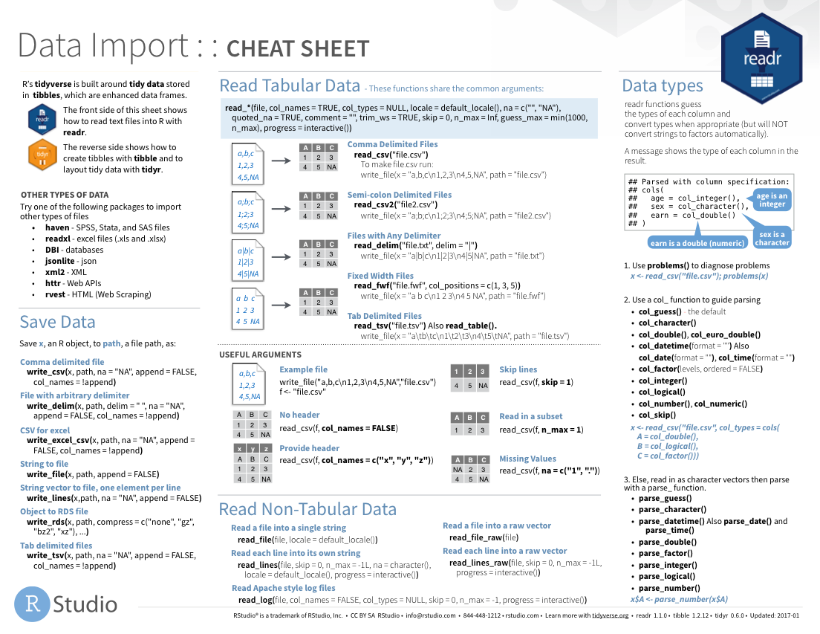
Notes:
Cheat sheets would go here

Slide 8
Notes:
As would other packages that do things

